Slide 1
Final Presentation
Truman Forey

Slide 2
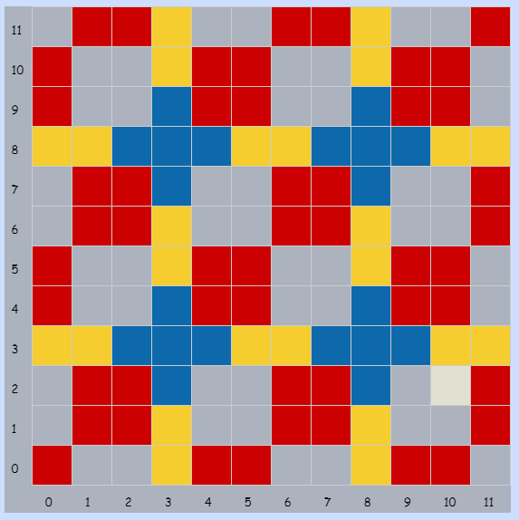
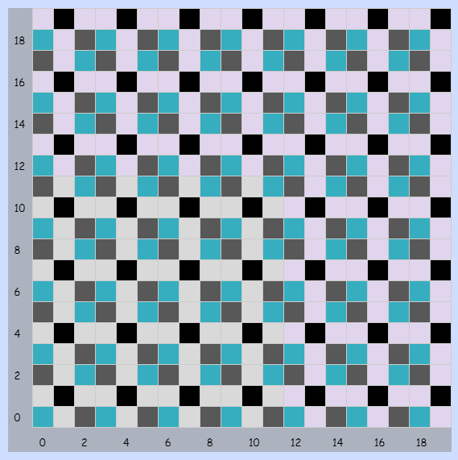
1 - Patterns
If this was made in Bricklayer-lite, then the patterns could be easily repeated
My original pattern
The pattern I extended
Notes:
The original goal was to make a repeatable pattern, and then download another person’s and extend it.

Slide 3
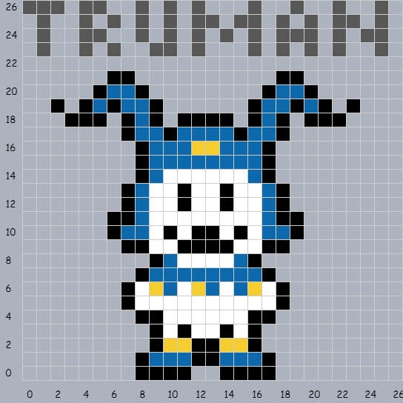
2 – Pixel Art
Due to the organic shape of the
character, Bricklayer wouldn’t have
made this much easier.

Slide 4
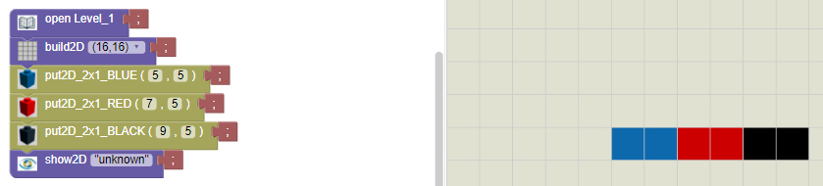

3 – Saving in Bricklayer
This is the first save I made as I was learning Bricklayer. There’s nothing to talk about, really.

Slide 5
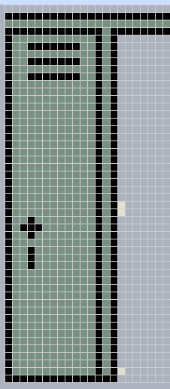
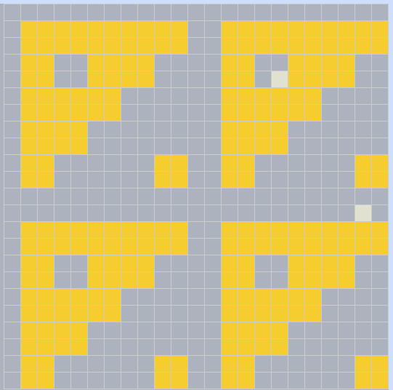
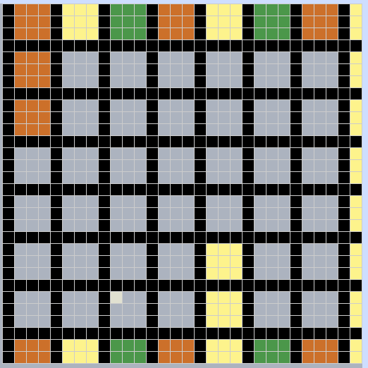
5 – Objects Around Bryan
I couldn’t get these finished because I had to manually place the colors If I was using Bricklayer, this would be extremely easily done.
Not pictured: the
Cafeteria wall one.
(The Grid is weird about
how old projects
appear when brought
up again.)

Slide 6
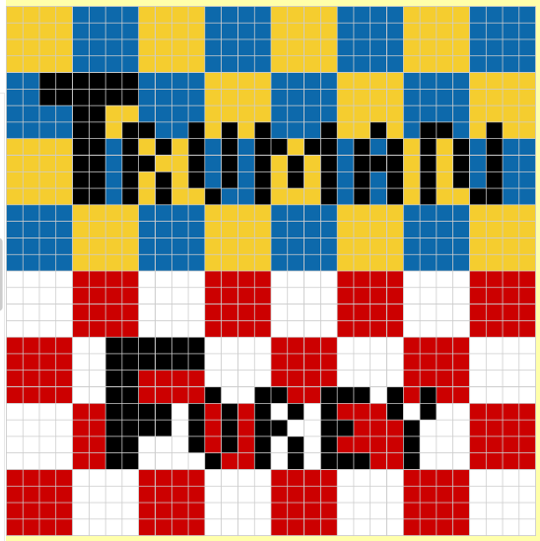
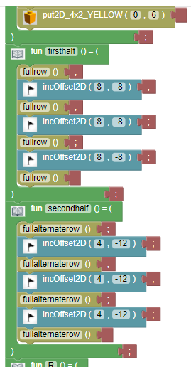
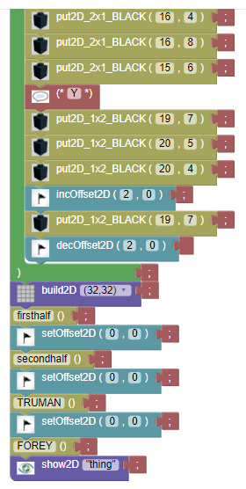
6 – Name Project
I started Level 2 of Bricklayer-lite here, so I got access to functions and offsets. Working with offsets was the hardest part of this project, but once I realized what I was doing wrong (setOffset 0), it all clicked together.

Slide 7
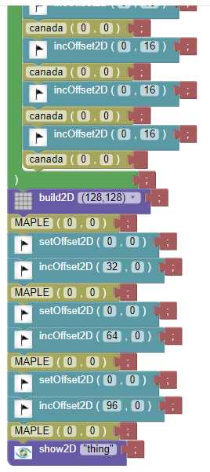
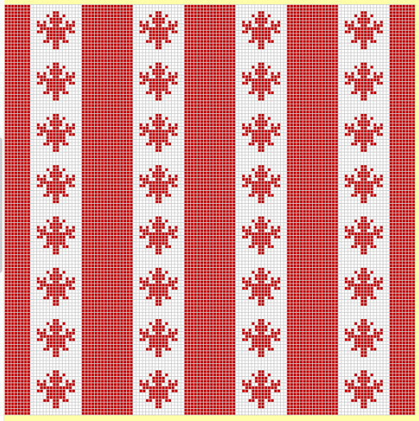
7 – Flag Project 1
I was still in Level 2, so I mainly relied on offsets to move the flag. They were still troublesome, but I managed to work past that.

Slide 8
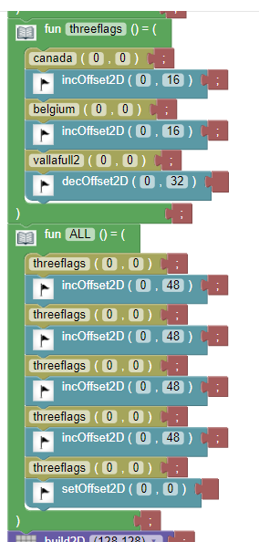
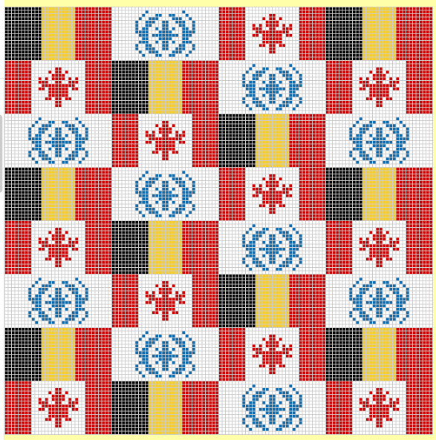
7 – Flag Project 2
I still used offsets here, which became a massive headache.
I managed to make it work, but it took much longer than
if I had gone to Level 3
and used ‘x+0.’

Slide 9
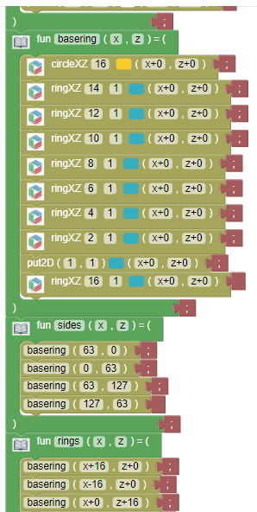
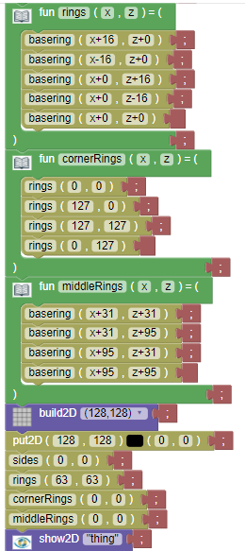
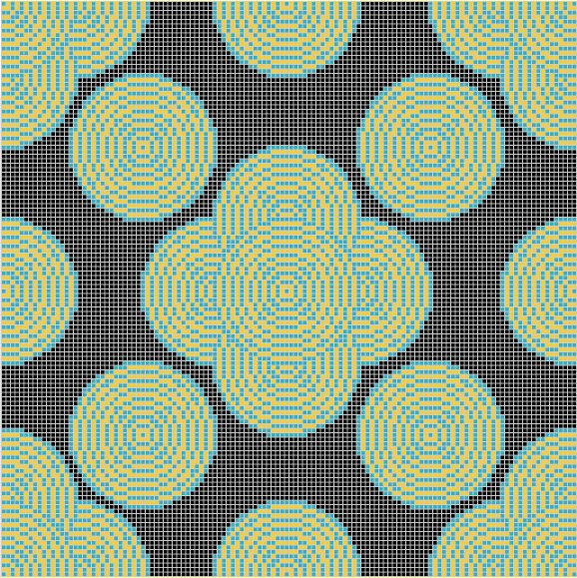
10 – Ring Project
My first project in Level 3. I started using ‘x+0’ here, which made this a lot easier than if I had kept using Offsets.
Small note: I made
a different pattern than
what we were ‘supposed’
to do.

Slide 10
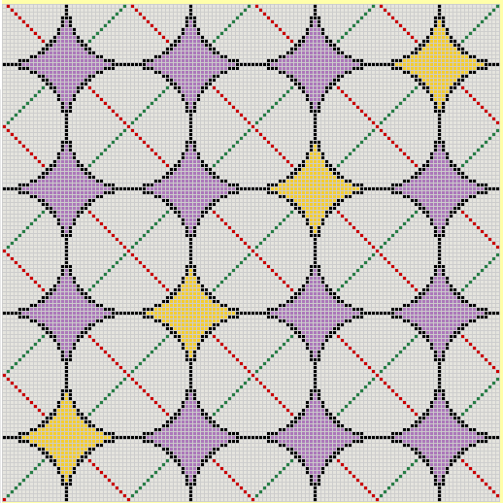
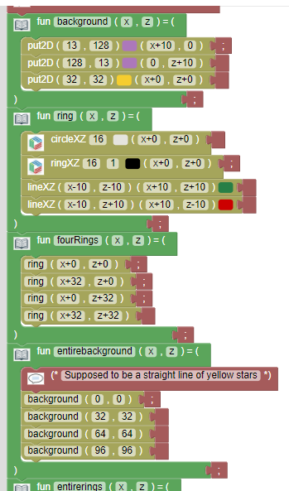
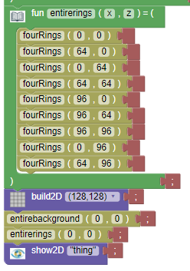
11 – All Functions
I continued using ‘x+0’ here, which was a simpler and more controlled method than offsets.
Notes:
As a reminder we had to use the following commands in this project: functions, lines, rings, circles, and put2D

Slide 11

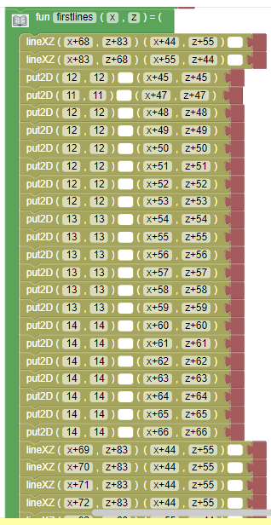

12 – Real Object
Nothing new in this project. Only thing of note is the massive amount of unique code I needed to make the arms.

Slide 12
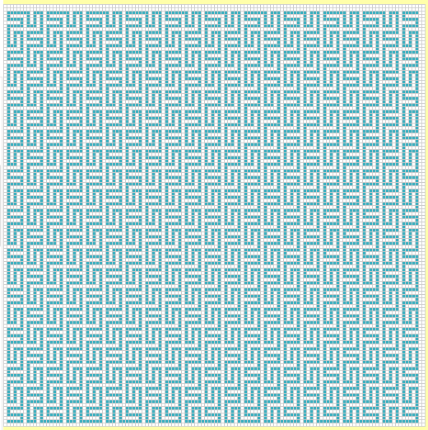
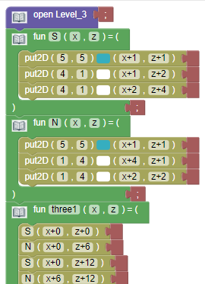
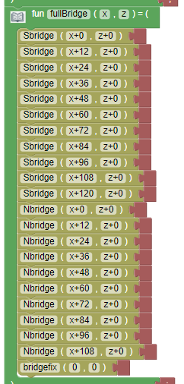
13 – Space-Filling Curves
Still nothing new. The interesting part is how the ‘S’ and backwards ‘N’ shapes were the easiest parts, and the bridge pieces connecting them were the hardest part. The bridges were still easy with functions.

Slide 13
END

